Slide 1






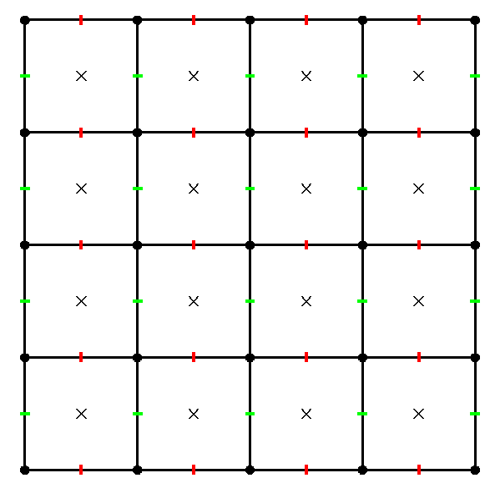
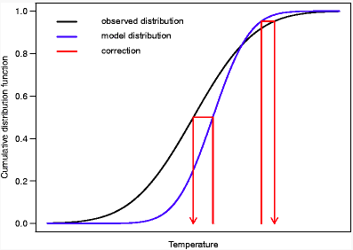
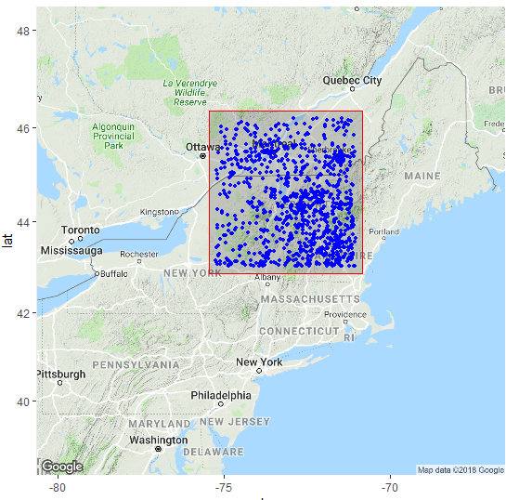
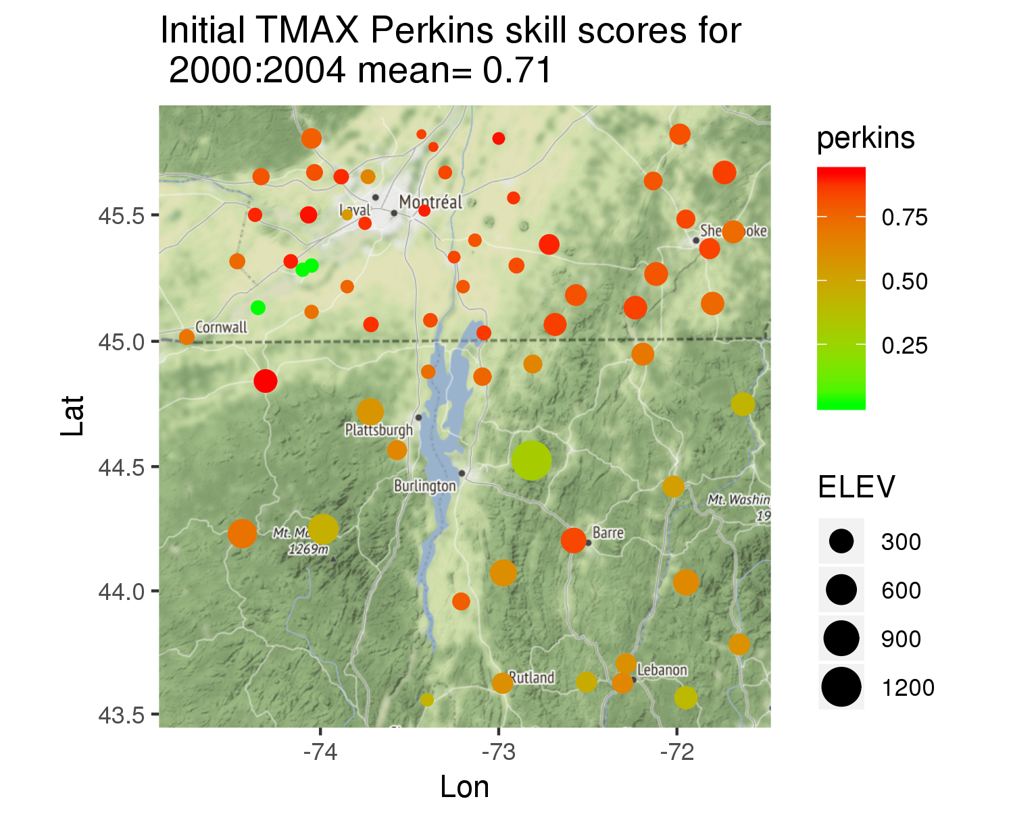
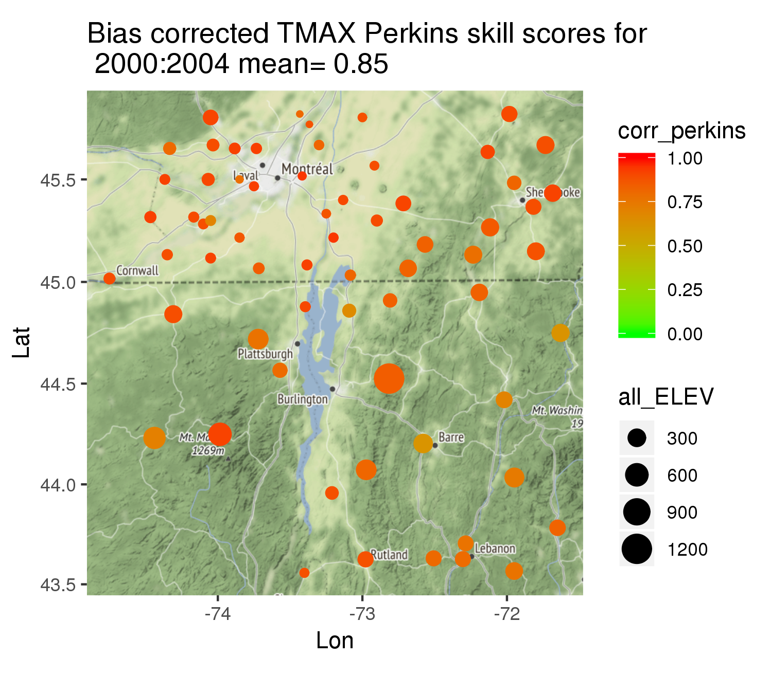

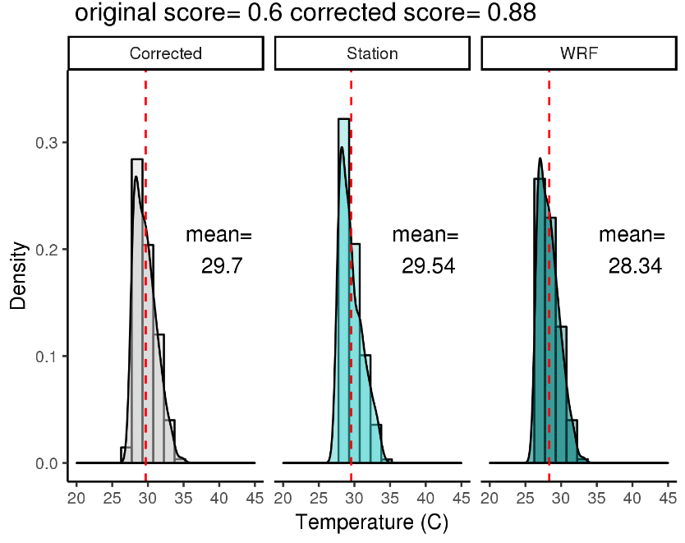
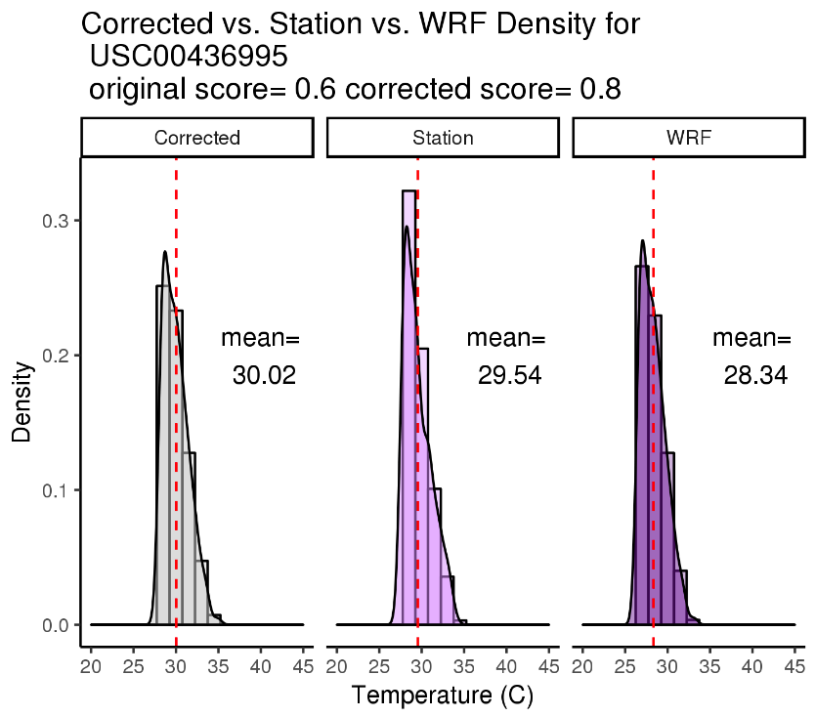
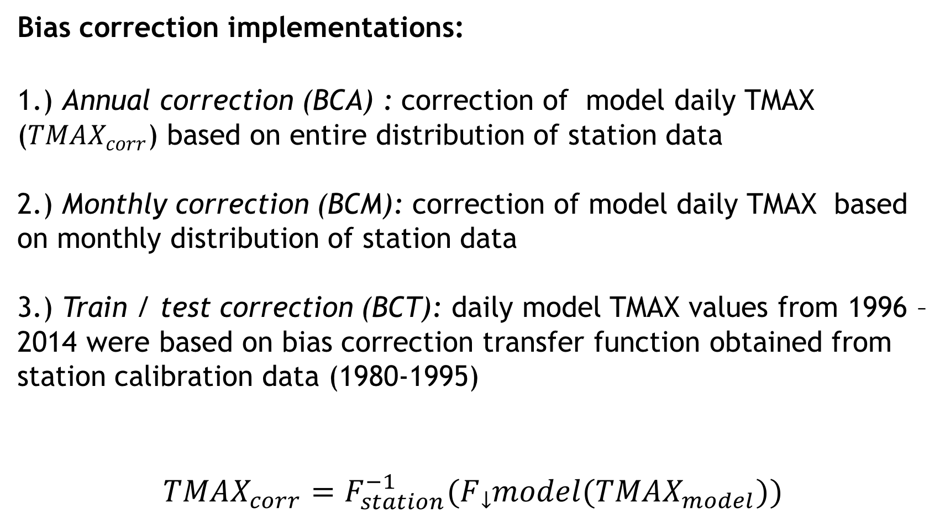
Assessing the Effectiveness of Empirical Quantile Mapping for Bias Correcting Historical Extreme Temperature Projections from a Climate Model
Ann Marie Matheny^{[1]}, Maike Holthuijzen^{[2]}
Indiana University¹, University of Vermont²
Introduction
Methods
Discussion
The Lake Champlain watershed basin is likely to experience changes in extreme climate events, which could negatively impact the socio-economic resilience of this region. Regional Climate Models (RCMs) are useful tools for modeling regional climate, but like all climate models, they are biased, especially in regards to extreme events² . In this study, we
compared extreme maximum temperature distributions from station data to those of RCMs and
applied three implementations of bias correction (empirical quantile mapping) to RCM simulations based on station data.
Our study is a first step in a larger research project investigating the changes in patterns of extreme events in the Lake Champlain Basin³
Data:
Model data: daily Weather and research forecasting model (WRF) projections
Station data: daily observations from Global historical climate network⁴
Time period: 1980-2014
Definition of extreme event: upper 90th percentile distribution of TMAX
73 stations were paired with the nearest WRF grid point
Quantifying the accuracy of WRF
Perkins Skill Score: measures overlap between 2 probability distribution functions (PDFs)¹
Ranges between 0 and 1.
1 = perfect match, 0 = no match.
Bias correction implementations:
1.) Annual correction (BCA) : correction of model daily TMAX ($TMAX_{corr}$) based on entire distribution of station data
2.) Monthly correction (BCM): correction of model daily TMAX based on monthly distribution of station data
3.) Train / test correction (BCT): daily model TMAX values from 1996 – 2014 were based on bias correction transfer function obtained from station calibration data (1980-1995)
$$TMAX_{corr}=F_{station}^{−1}(F_model(TMAX_{model}))$$
We found:
Spatial trends in Perkins skill scores between raw and bias corrected WRF and station data
BCA and BCM performed well, while BCT resulted in marginal improvements
Perkins skill scores were larger in Canada, which could be due to greater density of stations and less topographical complexity than the southern portion of the study area
BCA and BCM likely resulted in greater skill scores because the entire distribution of station data was used to correct WRF data. Worse performance of BCT could be due to an inadequate calibration period or greater variability in the chosen calibration period (1980-1995)
BCA and BCM are likely overfitting, resulting in inflated skill scores. For corrected future data, historical station data must be used, so although BCT performed worse, it is a more realistic implementation of bias correction
Eq. 1: general formula for EQM
Figure 2) WRF grid structure. Xs denote grid center points. Output is on a 4x4km grid.
Figure 3) Empirical quantile mapping adjusts the cumulative distribution function (CDF) of model data based on the CDF of station data⁵.
Objectives
Examine spatial and temporal patterns of the extreme maximum temperature (TMAX) distributions between climate model simulations and station data. We investigated these patterns for:
station data and raw RCM climate simulations;
2. station data bias-corrected RCM climate simulations using 3 implementations of empirical quantile mapping, a bias correction technique
Figure 2
Conclusions and future work
By applying different BC methods to these models, we can better capture the projection of extreme events. Through the efforts of this project, regional models may overestimate TMAX, but monthly correction can produce a more accurate forecast. Corrected error may still suffer from topographic effects. This study serves as a good first step in aiding the scientific community’s strive to better estimate and adapt to extreme weather events.
Figure 3
Results
-Little variation in Perkins skill scores over time, but skill scores tended to be larger in the northern portion of study area
-All methods of bias correction increased the skill scores between WRF and station data. BCA and BCM performed best, followed by BCT
Figure 4
Figure 5
Acknowledgements
Many thanks to the members of the BREE Climate team for access technical support. Thank you to Vermont EPSCoR and the Center for Workforce Development and Diversity for granting me this opportunity.
Figures 4 and 5) Figure 4: Perkins skill scores over study area between raw WRF and station data. Figure 5: Perkins skill scores over study area following BCA (only a subset of years shown)
Want to learn more? Scan me!
Figure 1
Lake Champlain basin study area comprised of New York, Vermont, New Hampshire and part of Canada showing the locations of all climate stations indicated in blue (only a portion of these stations were used in this study).
Figures 6 and 7) 90th percentile distributions of TMAX among station, WRF, and BCA corrected WRF data for 2 individual stations and nearest WRF grid points
References
[1] S. E. Perkins, A. J. Pitman, N. J. Holbrook, and J. Mcaneney. Evaluation of the ar4 climate models’ simulated daily maximum temperature, minimum temperature, and precipitation over australia using probability density functions. Journal of Climate, 20(17):4356–4376, Jan 2007.
[2] Justin Guilbert, Brian Beckage, Jonathan M. Winter, Radley M. Horton, Timothy Perkins, and Arne Bomblies. Impacts of projected climate change over the lake champlain basin in vermont. Journal of Applied Meteorology and Climatology, 53(8):1861–1875, Aug 2014.
[3] “Current Research.” Current Research | Vermont EPSCoR, Vermont EPSCoR, epscor.w3.uvm.edu/2/bree.
[4] “Global Historical Climatology Network (GHCN).” National Climatic Data Center, NOAA.
[5] Maraun, Douglas. “Bias Correcting Climate Change Simulations - a Critical Review.” Current Climate Change Reports, vol. 2, no. 4, 2016, pp. 211–220
Figure 6
Figure 7

